Slide 1

CHAPTER 4
ELEMENTARY NUMBER THEORY AND METHODS OF PROOF
Copyright © Cengage Learning. All rights reserved.

Slide 2

4.10
Application: Algorithms
Copyright © Cengage Learning. All rights reserved.

Slide 3
Application: Algorithms
The word algorithm refers to a step-by-step method for performing some action.
Some examples of algorithms in everyday life are food preparation recipes, directions for assembling equipment or hobby kits, sewing pattern instructions, and instructions for filling out income tax forms.
Part of elementary school mathematics is devoted to learning algorithms for doing arithmetic such as multidigit addition and subtraction, multidigit (long) multiplication, and long division.

Slide 4
An Algorithmic Language

Slide 5

An Algorithmic Language
The algorithmic language used in this book is a kind of pseudocode, combining elements of Python, C,
and Java, and ordinary, but fairly precise, English.
We will use some of the formal constructs of computer languages—such as assignment statements, loops, and so forth—but we will ignore the more technical details, such as the requirement for explicit end-of-statement delimiters, the range of integer values available on a particular installation, and so forth.

Slide 6
An Algorithmic Language
In high-level computer languages, the term variable is used to refer to a specific storage location in a computer’s memory.
To say that the variable x has the value 3 means that the memory location corresponding to x contains the number 3.
A given storage location can hold only one value at a time. So if a variable is given a new value during program execution, then the old value is erased.

Slide 7

An Algorithmic Language
The data type of a variable indicates the set in which the variable takes its values, whether the set of integers, or real numbers, or character strings, or the set {0, 1} (for a Boolean variable), and so forth.
An assignment statement gives a value to a variable. It has the form
where x is a variable and e is an expression. This is read “x is assigned the value e” or “let x be e.”

Slide 8
An Algorithmic Language
When an assignment statement is executed, the expression e is evaluated (using the current values of all the variables in the expression), and then its value is placed in the memory location corresponding to x (replacing any previous contents of this location).
Ordinarily, algorithm statements are executed one after another in the order in which they are written. Conditional statements allow this natural order to be overridden by using the current values of program variables to determine which algorithm statement will be executed next.

Slide 9
An Algorithmic Language
Conditional statements are denoted either
a. if (condition) or b. if (condition) then s₁
then s₁
else s₂
where condition is a predicate involving algorithm variables and where s₁ and s₂ are algorithm statements or groups of algorithm statements. We generally use indentation to indicate that statements belong together as a unit.

Slide 10
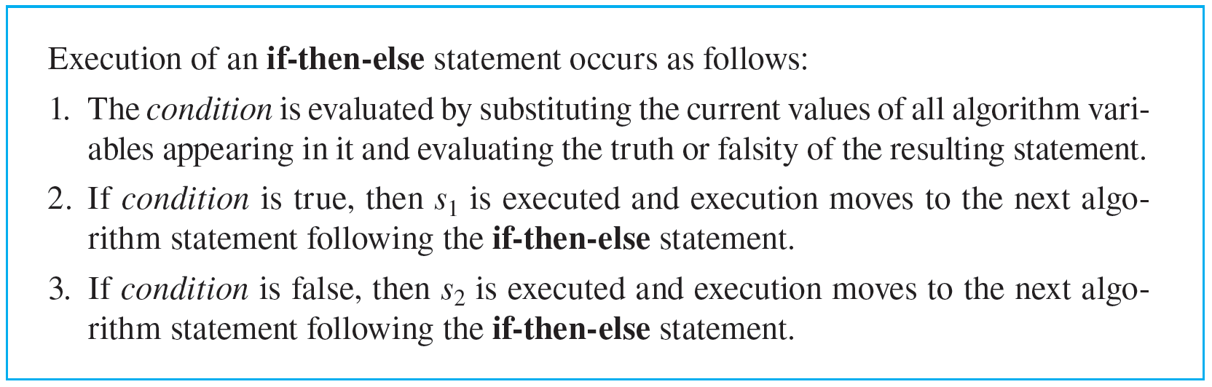
An Algorithmic Language
When ambiguity is possible, however, we may explicitly bind a group of statements together into a unit by preceding the group with the word do and following it with the words end do.

Slide 11
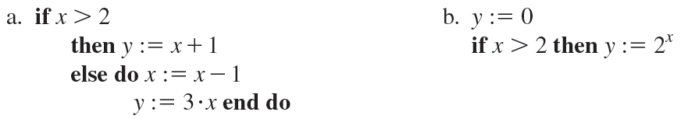
Example 4.10.1 – Execution of if-then-else and if-then Statements
Consider the following algorithm segments:
What is the value of y after execution of these segments for the following values of x?
ⅰ. x = 5
ⅱ. x = 2

Slide 12
Example 4.10.1 – Solution
a. (ⅰ) Because the value of x is 5 before execution, the guard condition x > 2 is true at the time it is evaluated.
Hence the statement following then is executed, and so the value of x + 1 = 5 + 1 is computed and placed in the storage location corresponding to y. So after execution, y = 6.
(ⅱ) Because the value of x is 2 before execution, the guard condition x > 2 is false at the time it is evaluated.

Slide 13

Example 4.10.1 – Solution
continued
Hence the statement following else is executed. The value of x − 1 = 2 − 1 is computed and placed in the storage location corresponding to x, and the value of 3 · x = 3 · 1 is computed and placed in the storage location corresponding to y. So after execution, y = 3.
b. (i) Since x = 5 initially, the condition x > 2 is true at the time it is evaluated. So the statement following then is executed, and y obtains the value

Slide 14
Example 4.10.1 – Solution
continued
(ii) Since x = 2 initially, the condition x > 2 is false at the time it is evaluated.
Execution, therefore, moves to the next statement following the if-then statement, and the value of y does not change from its initial value of 0.

Slide 15
An Algorithmic Language
A while loop has the form
while (condition)
[statements that make up
the body of the loop]
end while
where condition is a predicate involving algorithm variables. The word while marks the beginning of the loop, and the words end while mark its end.

Slide 16
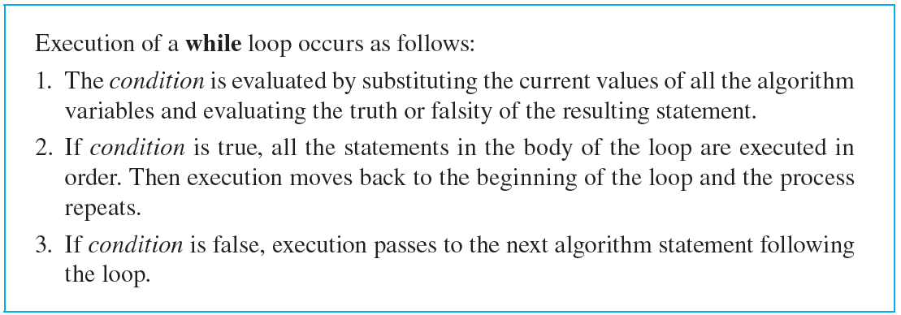
An Algorithmic Language

Slide 17
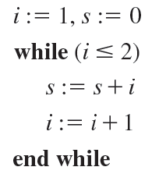
Example 4.10.2 – Tracing Execution of a while Loop
Trace the execution of the following algorithm segment by finding the values of all the algorithm variables each time they are changed during execution:

Slide 18
Example 4.10.2 – Solution
Since i is given an initial value of 1, the condition i ≤ 2 is true when the while loop is entered.
So the statements within the loop are executed in order:
s = 0 + 1 = 1 and i = 1 + 1 = 2.
Then execution passes back to the beginning of the loop.
The condition i ≤ 2 is evaluated using the current value of i, which is 2.

Slide 19
Example 4.10.2 – Solution
continued
The condition is true, and so the statements within the loop are executed again:
s = 1 + 2 = 3 and i = 2 + 1 = 3.
Then execution passes back to the beginning of the loop.
The condition i ≤ 2 is evaluated using the current value of i, which is 3.
This time the condition is false, and so execution passes beyond the loop to the next statement of the algorithm.

Slide 20
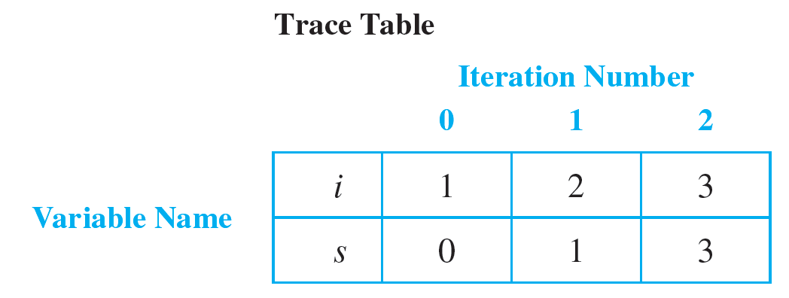
Example 4.10.2 – Solution
continued
This discussion can be summarized in a table, called a trace table, that shows the current values of algorithm variables at various points during execution. The trace table for a while loop generally gives all values immediately following each iteration of the loop. (“After the zeroth iteration” means the same as “before the first iteration.”)

Slide 21
An Algorithmic Language
The second form of iteration we will use is a for-next loop. A for-next loop has the following form:
for variable
initial expression to final expression
[statements that make up
the body of the loop]
next (same) variable

Slide 22
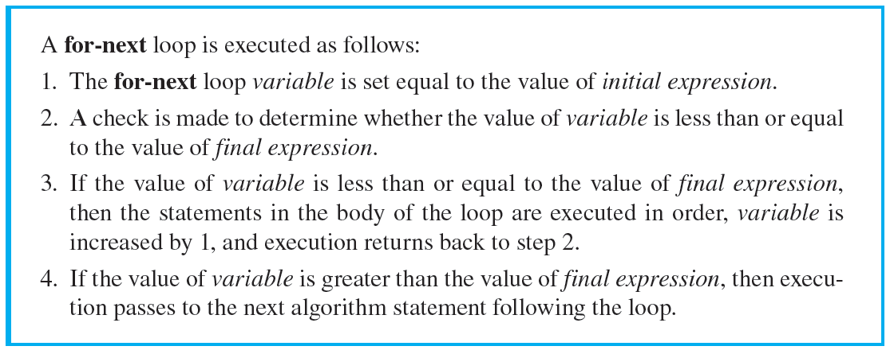
An Algorithmic Language

Slide 23
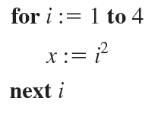
Example 4.10.3 – Trace Table for a for-next Loop
Convert the for-next loop shown below into a while loop. Construct a trace table for the loop.

Slide 24
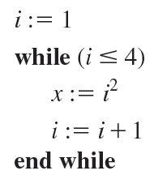
Example 4.10.3 – Solution
The given for-next loop is equivalent to the following:

Slide 25
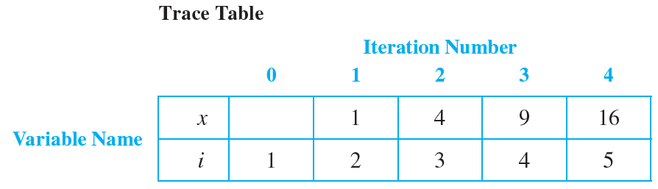
Example 4.10.3 – Solution
continued
Its trace table is as follows:

Slide 26
A Notation for Algorithms

Slide 27
A Notation for Algorithms
We will express algorithms as subroutines that can be called upon by other algorithms as needed and used to transform a set of input variables with given values into a set of output variables with specific values.
The output variables and their values are assumed to be returned to the calling algorithm. For example, the division algorithm specifies a procedure for taking any two positive integers as input and producing the quotient and remainder of the division of one number by the other as output.

Slide 28
A Notation for Algorithms
Whenever an algorithm requires such a computation, the algorithm can just “call” the division algorithm to do the job.
We generally include the following information when describing algorithms formally:
1. The name of the algorithm, together with a list of input and output variables.
2. A brief description of how the algorithm works.

Slide 29
A Notation for Algorithms
3. The input variable names, labeled by data type (whether integer, real number, and so forth).
4. The statements that make up the body of the algorithm, possibly with explanatory comments.
5. The output variable names, labeled by data type.

Slide 30
The Division Algorithm

Slide 31
The Division Algorithm
For an integer a and a positive integer d, the quotient-remainder theorem guarantees the existence of integers q and r such that
a = dq + r and 0 ≤ r < d.

Slide 32
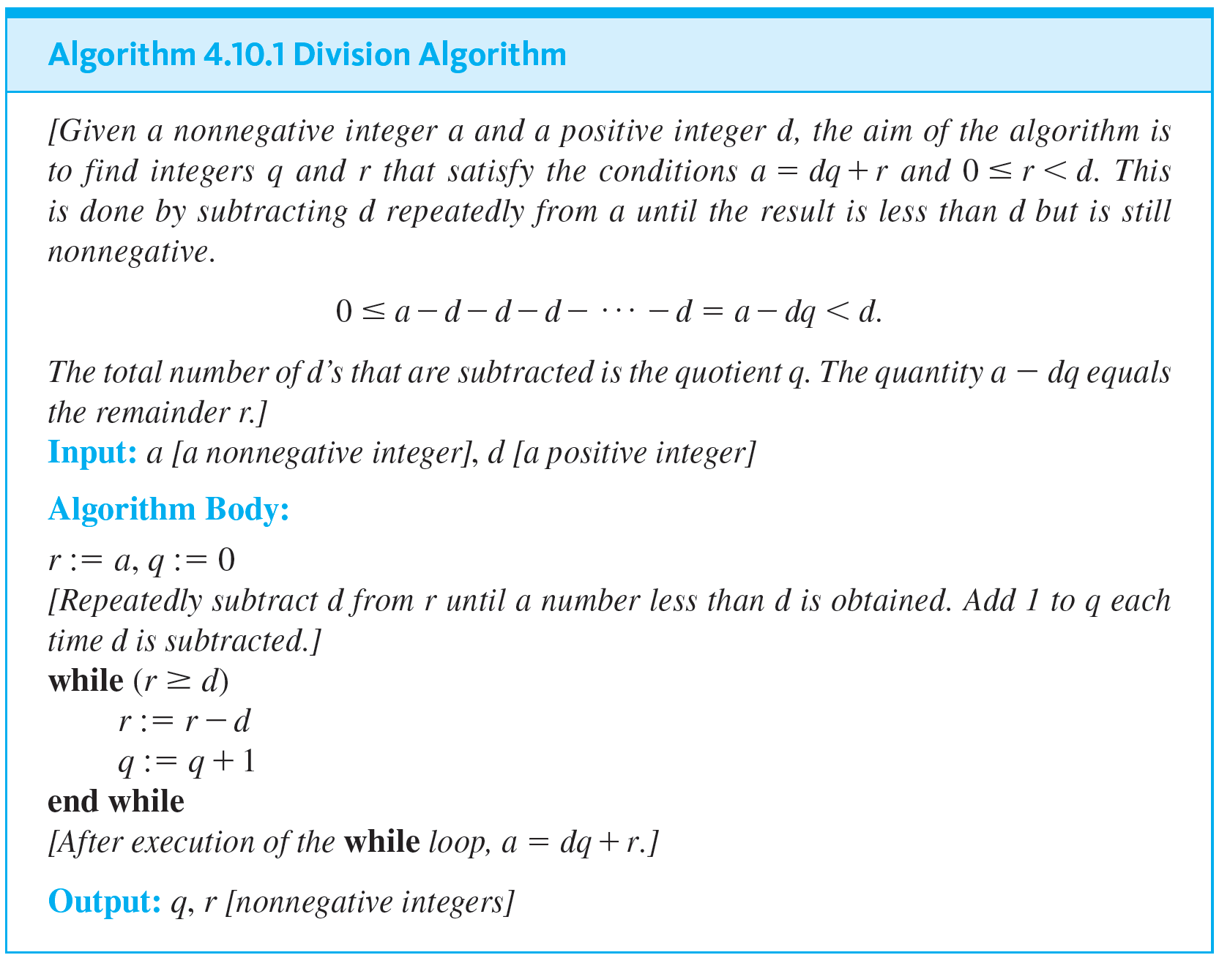
The Division Algorithm

Slide 33
Example 4.10.4 – Tracing the Division Algorithm
Trace the action of Algorithm 4.10.1 on the input variables a = 19 and d = 4.

Slide 34
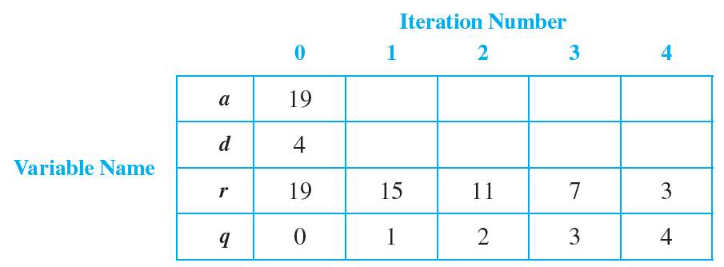
Example 4.10.4 – Solution
Make a trace table as shown below.
The column under the kth iteration gives the states of the variables after the kth iteration of the loop.

Slide 35
The Euclidean Algorithm

Slide 36
The Euclidean Algorithm

Slide 37
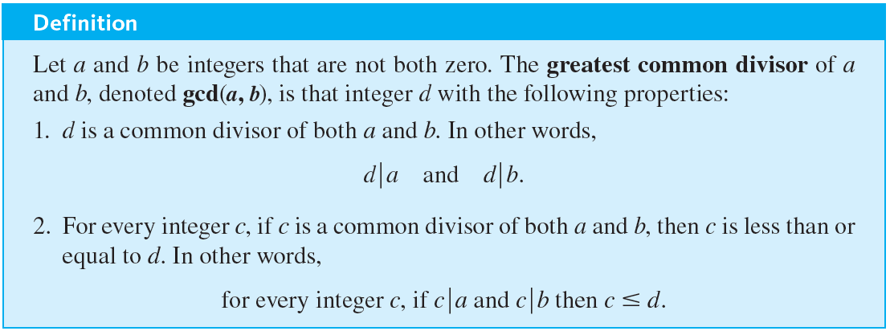
The Euclidean Algorithm
The greatest common divisor of two integers a and b is the largest integer that divides both a and b. For example, the greatest common divisor of 12 and 30 is 6. The Euclidean algorithm provides a very efficient way to compute the greatest common divisor of two integers.

Slide 38

Example 4.10.5 – Calculating Some gcd’s
a. Find gcd(72, 63).
c. In the definition of greatest common divisor, gcd(0, 0) is not allowed. Why not? What would gcd(0, 0) equal if it were found in the same way as the greatest common divisors for other pairs of numbers?

Slide 39






Example 4.10.5 – Solution
a. 72 = 9 · 8 and 63 = 9 · 7. So
and no integer larger than 9 divides both 72 and 63. Hence gcd(72, 63) = 9.
b. By the laws of exponents,
It follows that
and by the unique factorization of integers theorem, no integer larger than
(because no more than twenty 2’s divide
Divides both
no 3’s divide
and no 5’s divide

Slide 40

Example 4.10.5 – Solution
continued
Hence
c. Suppose gcd(0, 0) were defined to be the largest common factor that divides 0 and 0. The problem is that every positive integer divides 0 and there is no largest integer.
So there is no largest common divisor!

Slide 41
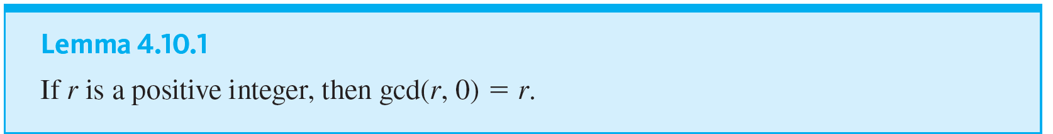
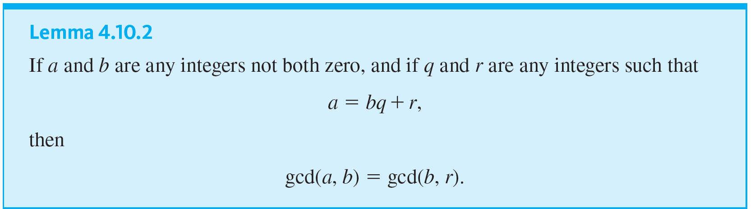
The Euclidean Algorithm

Slide 42
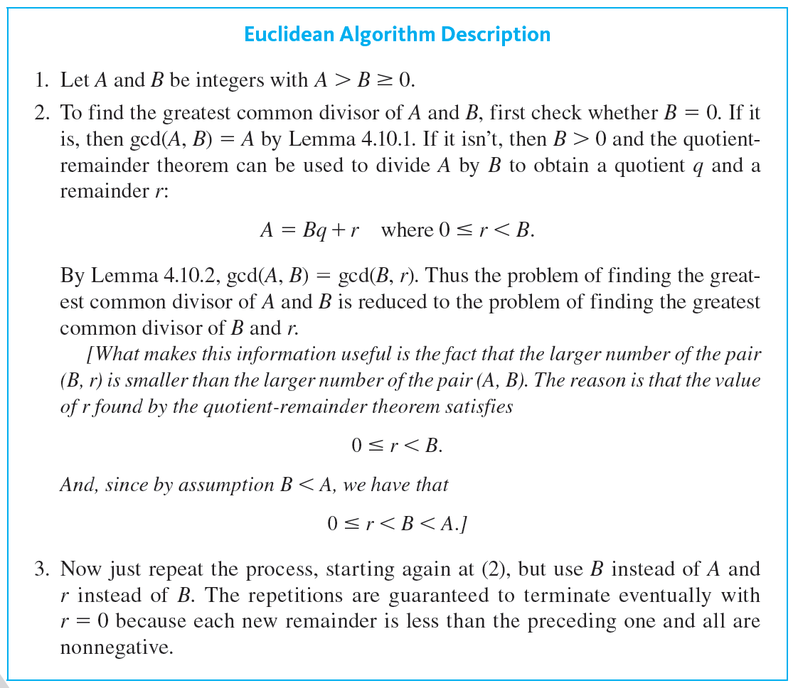
The Euclidean Algorithm

Slide 43
Example 4.10.6 – Hand-Calculation of gcd’s Using the Euclidean Algorithm
Use the Euclidean algorithm to find gcd(330, 156).

Slide 44
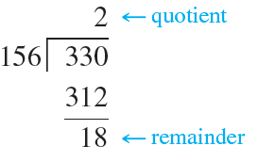
Example 4.10.6 – Solution
1. Divide 330 by 156:
Thus 330 = 156 · 2 + 18, and hence gcd(330, 156) = gcd(156, 18) by Lemma 4.10.2.

Slide 45
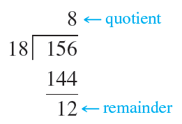
Example 4.10.6 – Solution
continued
2. Divide 156 by 18:
Thus 156 = 18 · 8 + 12, and hence gcd(156, 18) = gcd(18, 12) by Lemma 4.10.2.

Slide 46
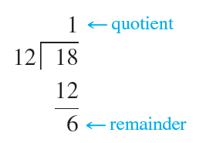
Example 4.10.6 – Solution
continued
3. Divide 18 by 12:
Thus 18 = 12 · 1 + 6, and hence gcd(18, 12) = gcd(12, 6) by Lemma 4.10.2.

Slide 47
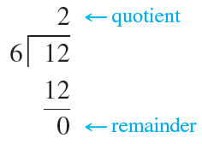
Example 4.10.6 – Solution
continued
4. Divide 12 by 6:
Thus 12 = 6 · 2 + 0, and hence gcd(12, 6) = gcd(6, 0) by Lemma 4.10.2. Putting all the equations above together gives
gcd(330, 156) = gcd(156, 18)
= gcd(18, 12)

Slide 48
Example 4.10.6 – Solution
continued
= gcd(12, 6)
= gcd(6, 0)
= 6 by Lemma 4.10.1.
Therefore, gcd(330, 156) = 6.

Slide 49
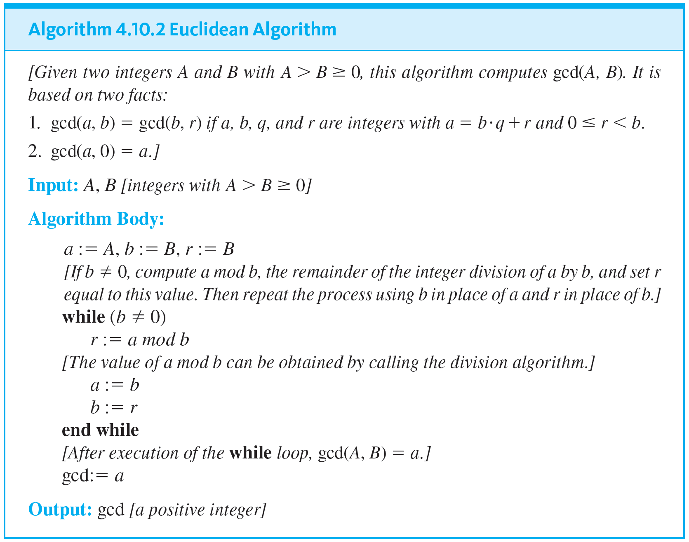
The Euclidean Algorithm
The following is a version of the Euclidean algorithm written using formal algorithm notation.

Slide 50
Example 4.10.7 – A Trace Table for the Euclidean Algorithm
Construct a trace table for Algorithm 4.10.2 using A = 330 and B = 156, the same numbers as in Example 4.10.6.

Slide 51
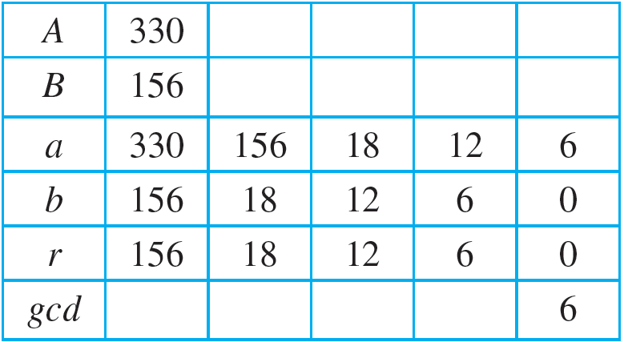
Example 4.10.7 – Solution

